Slide 1
Chapter 4. Digital Transmission
Transmission Mode
4-<number>

Slide 2

Transmission Modes
4-<number>

Slide 3
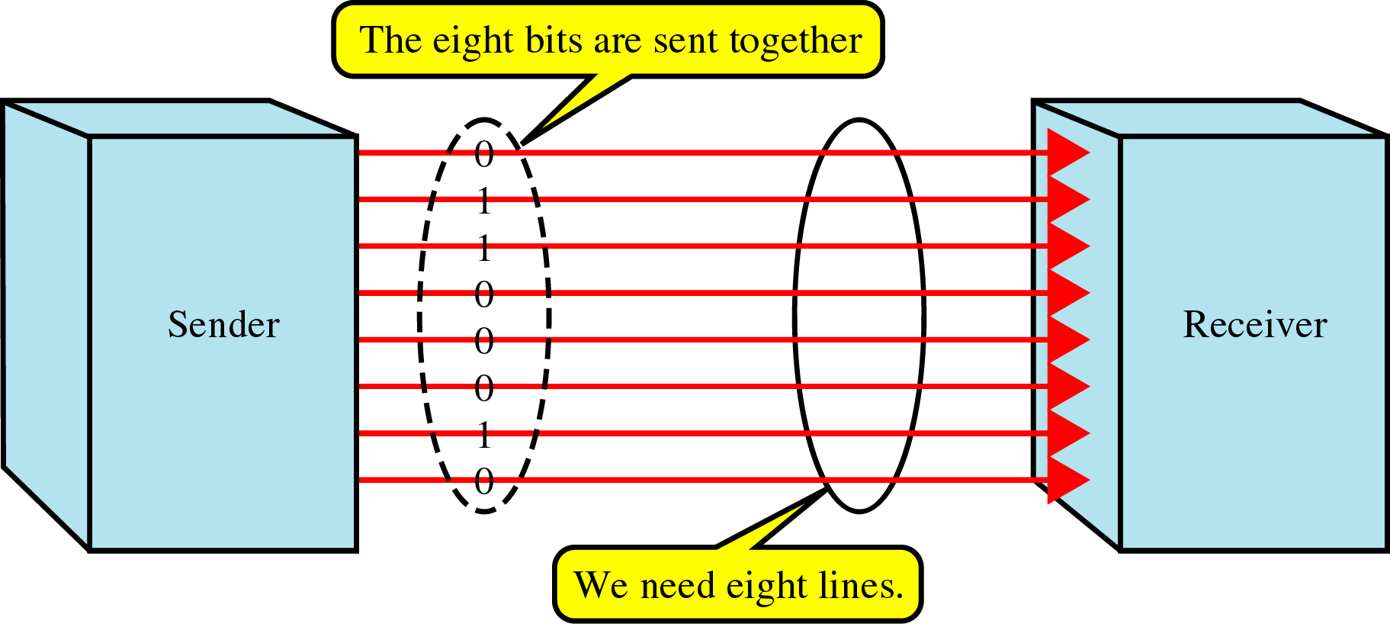
Parallel Transmission
Use n wires to send n bits at one time synchronously
Advantage: speed
Disadvantage: cost ⇒ Limited to short distances
4-<number>

Slide 4
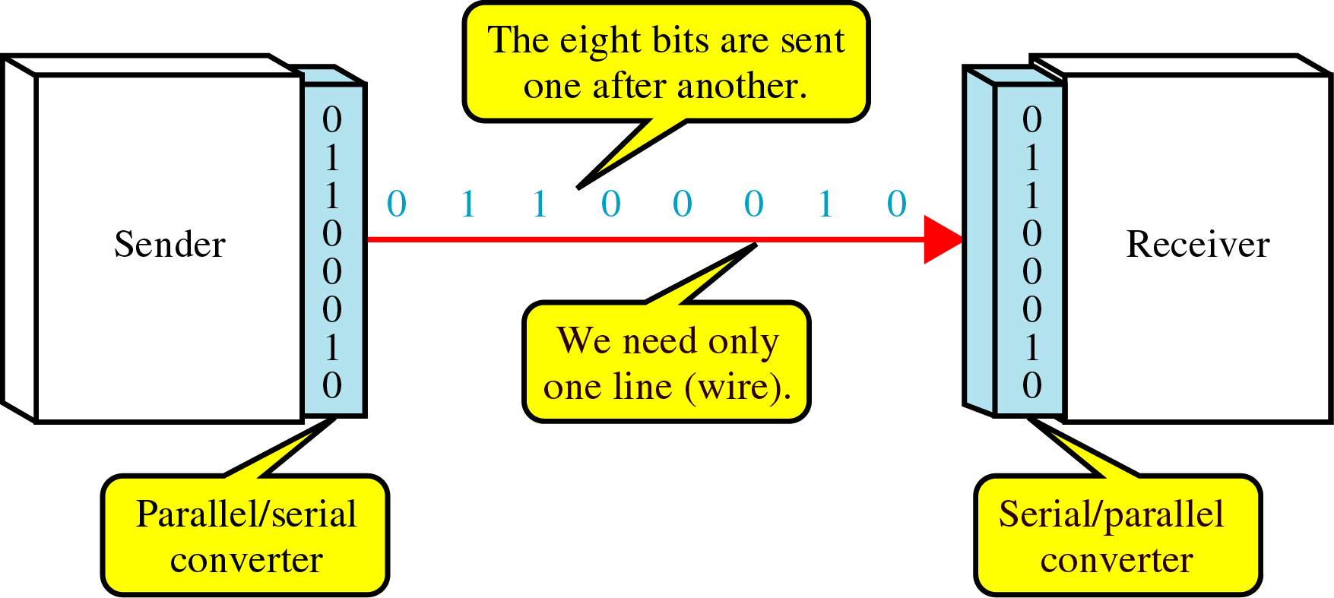
Serial Transmission
On communication channel
Advantage: reduced cost
Parallel/serial converter is required
Three ways: asynchronous, synchronous, or isochronous
4-<number>

Slide 5
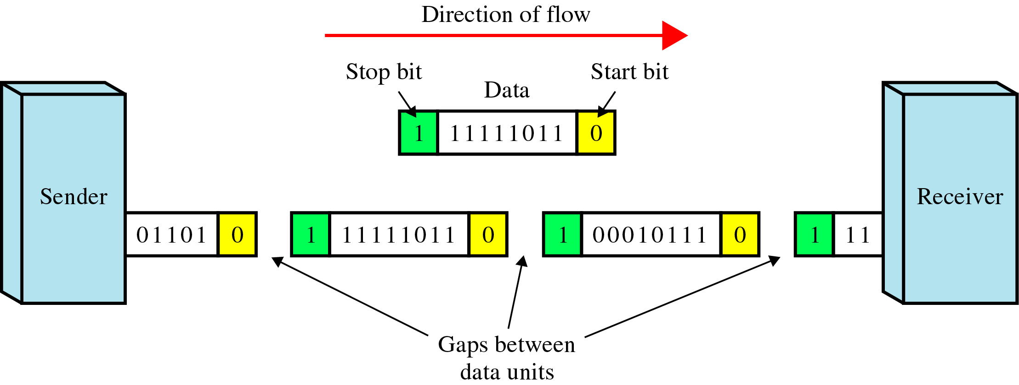
Asynchronous Transmission
Use start bit (0) and stop bits (1s)
A gap between two bytes: idle state or stop bits
It means asynchronous at byte level
Must still be synchronized at bit level
Good for low-speed communications (terminal)
4-<number>

Slide 6
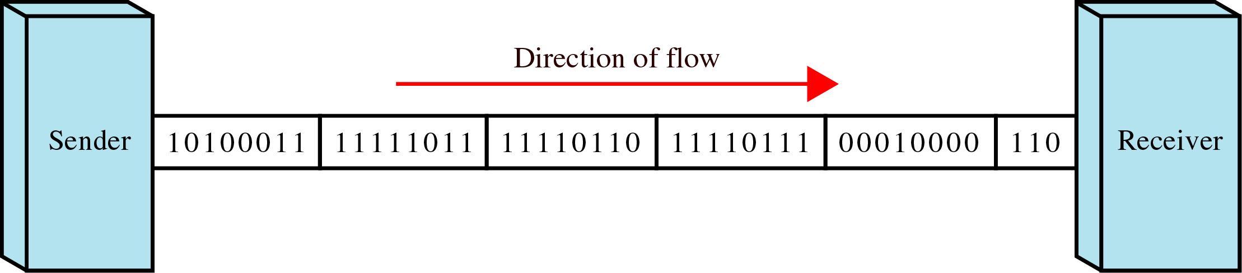
Synchronous Transmission
Bit stream is combined into “frames”
Special sequence of 1/0 between frames: No gap
Timing is important in midstream
Byte synchronization in the data link layer
Advantage: speed ⇒ high-speed transmission
4-<number>

